Slide 1
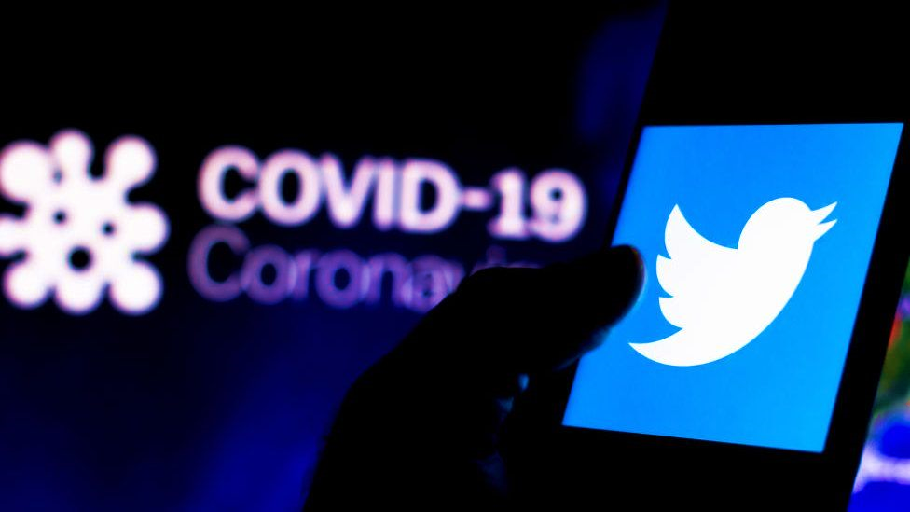
TWITTER DATA ANALYSIS
A detailed report on Twitter Trend Analysis using Python
BY – Archit Jain and Saksham Dhawan

Slide 2

Covid-19 Pandemic
Coronavirus disease 2019 (COVID-19) is a contagious disease caused by severe acute respiratory syndrome coronavirus 2 (SARS-CoV-2).
The first case was identified in Wuhan, China, in December 2019.
It has led to the postponement or cancellation of events, widespread supply shortages exacerbated by panic buying, agricultural disruption and food shortages, and decreased emissions of pollutants and greenhouse gases. Many educational institutions and public areas have been partially or fully closed.

Slide 3

Twitter-A Social Media For Revolution
Twitter is an American microblogging and social networking service on which users post and interact with messages known as tweets. Twitter is a huge social media platform.
Twitter was created by Jack Dorsey, Noah Glass, Biz Stone, and Evan Williams in March 2006 and launched in July of that year. By 2012, more than 100 million users posted 340 million tweets a day.
In 2013, it was one of the ten most-visited websites and has been described as "the SMS of the Internet".

Slide 4
Scope Of Project
1) Submit your Jupyter notebook analyzing twitter trends from the data provided. Our code will cover:
a) Generate a word cloud based on the tweets
b) Show the relative popularity of the hashtags
c) Show top 10 twitter handlers which were most active.

Slide 5
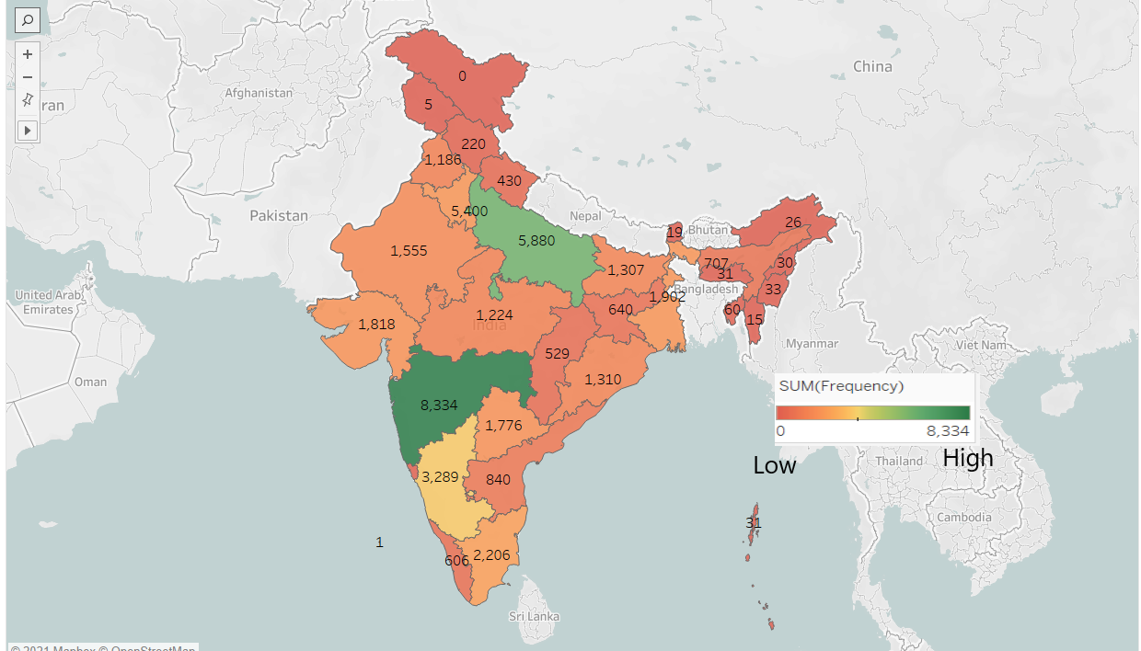
Distribution Of Number Of Tweets On the Basis Of States

Slide 6
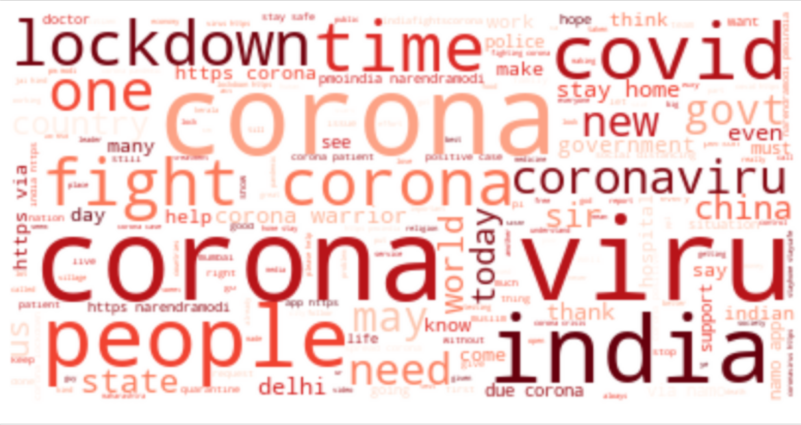
a) Generate a word cloud based on the tweets
A tag cloud (word cloud or wordle or weighted list in visual design) is a novelty visual representation of text data, typically used to depict keyword metadata (tags) on websites, or to visualize free form text. Tags are usually single words, and the importance of each tag is shown with font size or color. This format is useful for quickly perceiving the most prominent terms to determine its relative prominence. Bigger term means greater weight.

Slide 7
b) Show the relative popularity of the hashtags
Total Number of Hashtags in dataset : 17908
Total Number of Unique Hashtags in dataset : 11909
We divided the popularity of hashtags into two categories –
On the basis of number of counts of a hashtag
On the basis of number of retweets of a hashtag

Slide 8
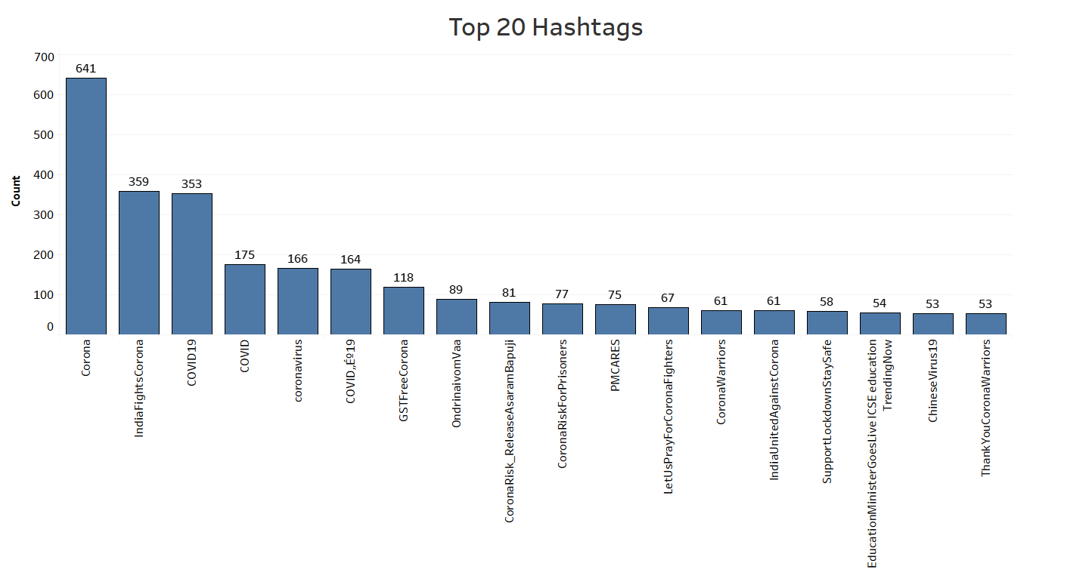
1) On the basis of number of counts of a hashtag
#Corona was the most popular tweet with a count of 641.

Slide 9
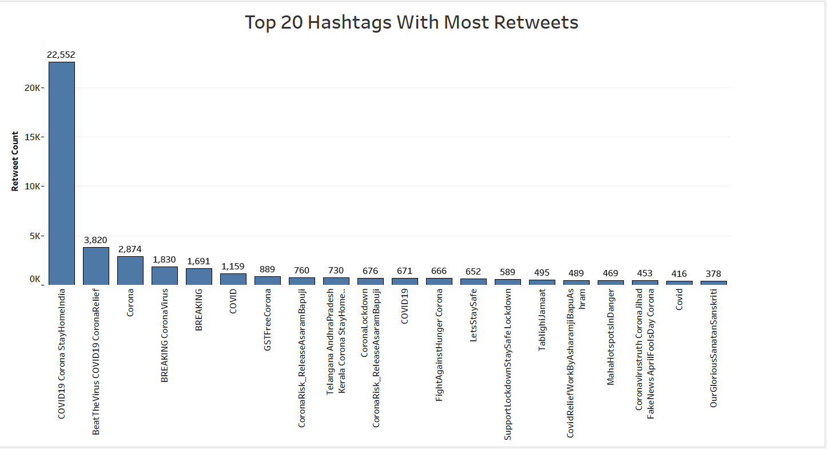
2) On the basis of number of retweets of a hashtag
#COVID19CoronaStayHomeIndia was the most popular hashtag as it had been tweeted 22.5K times.

Slide 10
c) Find 10 most active Twitter handlers
Total Number of Twitter Handlers in dataset : 44180
Total Number of Unique Twitter Handlers in dataset : 22447
To find the most active Twitter handlers we have created a condition that the total number of tweets tweeted by a twitter handler must be greater than 10
We divided this problem into three categories –
On the basis of total number of statuses till date
On the basis of most number of tweets
On the basis of time difference between two successive tweets

Slide 11
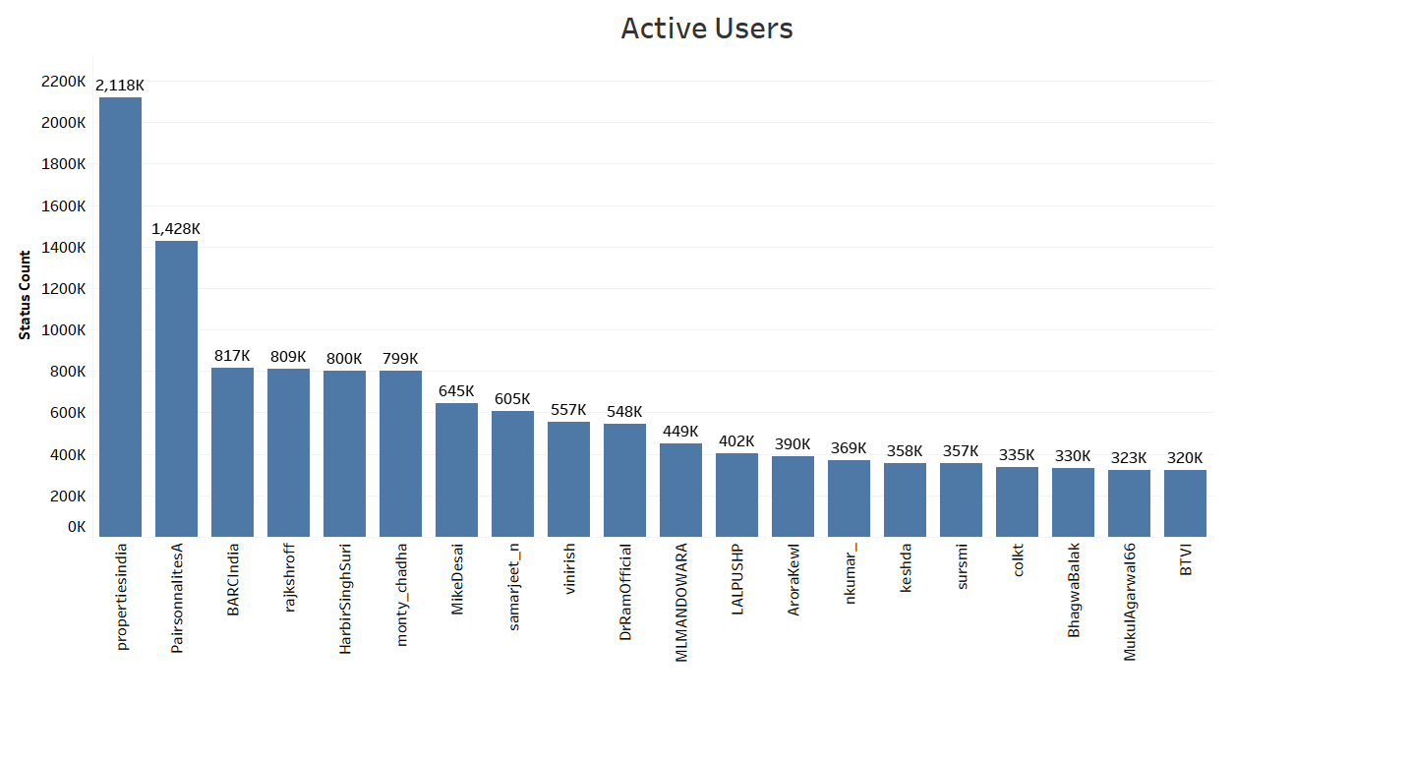
1) On the basis of total number of statuses till date
@Propertiesindia is the most active user of all times as he has the most number of statuses uploaded till date that is 21,18,000.

Slide 12
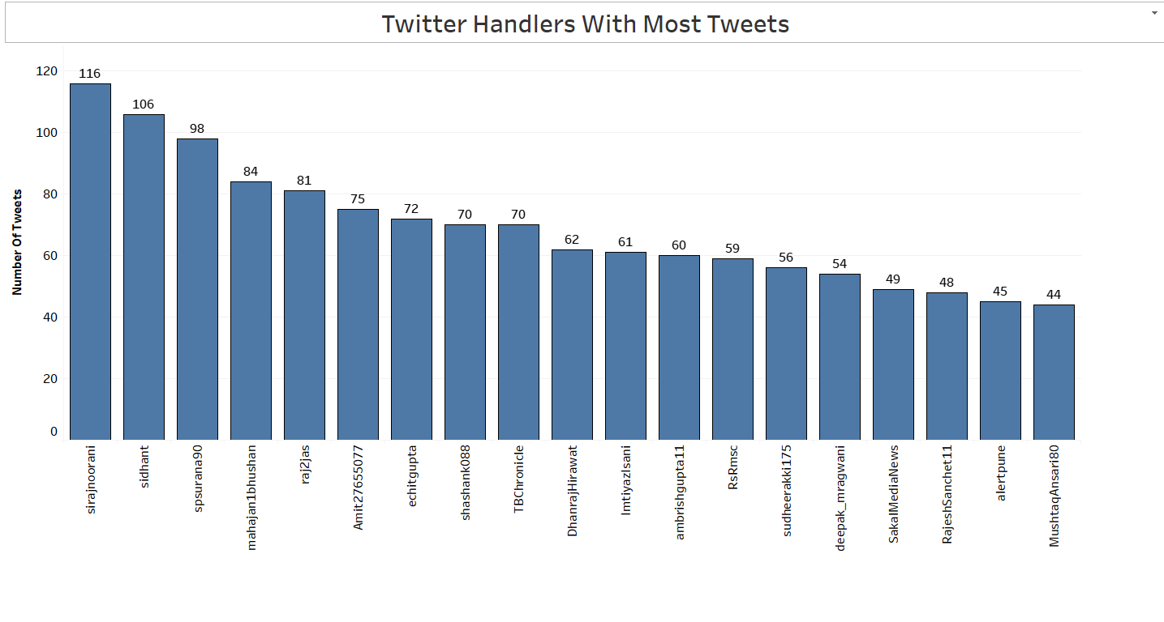
2) On the basis of most number of tweets
@sirajnoorani was the most active twitter user in the first one and a half months of lockdown with 116 tweets

Slide 13
3) On the basis of time difference between two successive tweets
While analyzing data under this category we found two kinds of users.
i) Who tweeted number of tweets in a single day and then never posted anything.
ii) Who kept tweeting at a regular interval of time for a long period of time.

Slide 14
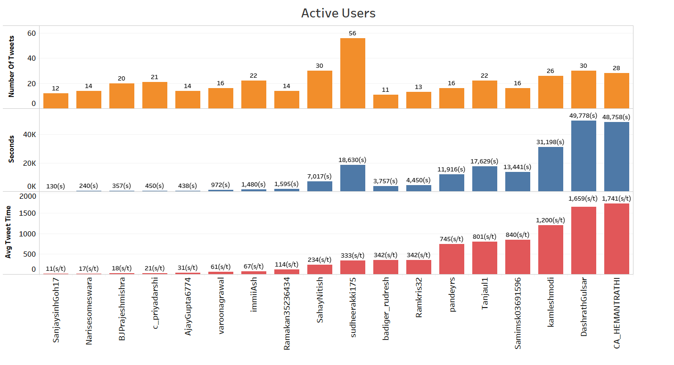
i) Who tweeted a number of tweets in a single day and then never posted anything
@SanjaysinhGoh17 was the most active user under this category as he tweeted 12 tweets in 130s at a rate of 10.8s per tweet

Slide 15
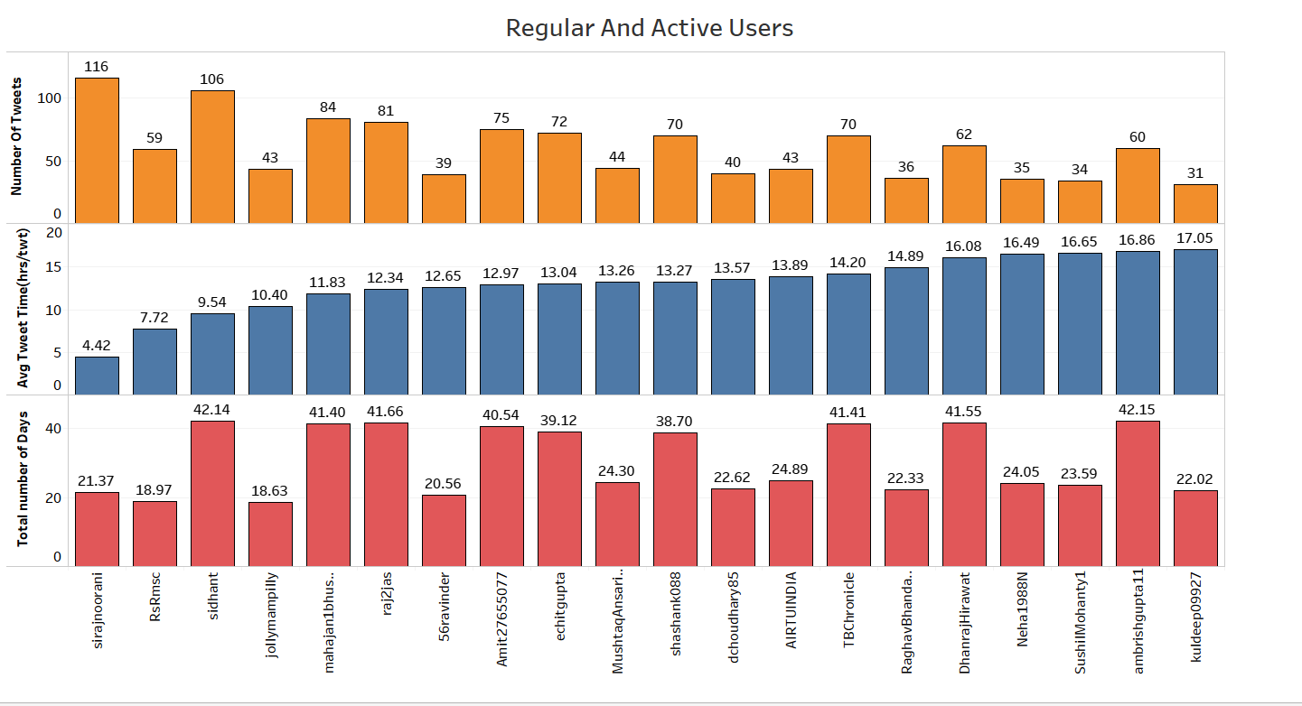
ii) Who kept tweeting at a regular interval of time for a long period of time
To solve this part we applied one more condition that the user must be active for at least 18 days.
@sirajnoorani was the most active user under this category as he tweeted 116 tweets at a rate of 4.42hrs per tweet and hence was active for 21 days.

Slide 16
Top 10 Twitter Handlers
While studying the data carefully we found that 8 twitter handlers who posted most number of tweets in the first one and a half months of lockdown were also present in the list of top 10 regular and active users who were active for at least 18 days and used to tweet at regular intervals. The name of these handlers are:-
@sirajnoorani (most active from 15th April-5th May with 116 tweets within 22 days)
@RsRmsc
@sidhant
@mahajan1Bhushan (most active between 26th March-14th April with 72 tweets within 20 days)
@raj2jas
@Amit27655077
@echitgupta
@shashank088

Slide 17
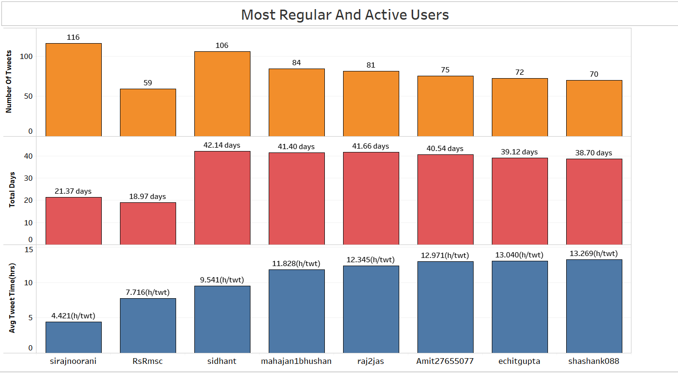
Tweets From 25th March-7th May

Slide 18
Observation Table
Observations | Results
Total number of hashtags in the tweets: | 17908
Total number of Unique hashtags: | 11909
Most number of counts of a hashtag | #Corona with 641 counts
Most number of retweets of a hashtag | #COVID19CoronaStayHomeIndia with 22.5k tweets
Total number of Twitter-handles in the tweets: | 44180
Total number of Unique Twitter-handles: | 22447
Handler with most number of total statuses till date: | Propertiesindia with 21,18,000 statuses
Handler with most number of tweets in first one and a half months: | sirajnoorani with 116 tweets
Handler tweeted maximum number of tweets in minimum time: | SanjaysinhGoh17 tweeted 12 tweets @10.8s/tweet
Handler who kept tweeting at a regular interval of time: | sirajnoorani tweeted 116 tweets @4.42hrs/tweet for 21 days
Most active user : | sirajnoorani (most active from 15th April-5th May with 116 tweets within 22 days)
 | mahajan1Bhushan (most active between 26th March-14th April with 72 tweets within 20 days)

